Slide 1
Refurbishing silicon showerhead
for
300 mm wafer
plasma etching process equipment

Slide 2
Nanocoating Plasma Systems, Inc.
4432 G Enterprise Street
Fremont, CA 94538
415-533-7696
glukhoy1@aol.com

Slide 3
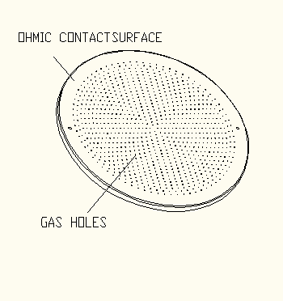
CATHODE (CEL)
Cathode serves for wafer etching processes, made from silicon crystal it comprises 900 holes with Dia 0.5 mm and 10mm deep

Slide 4
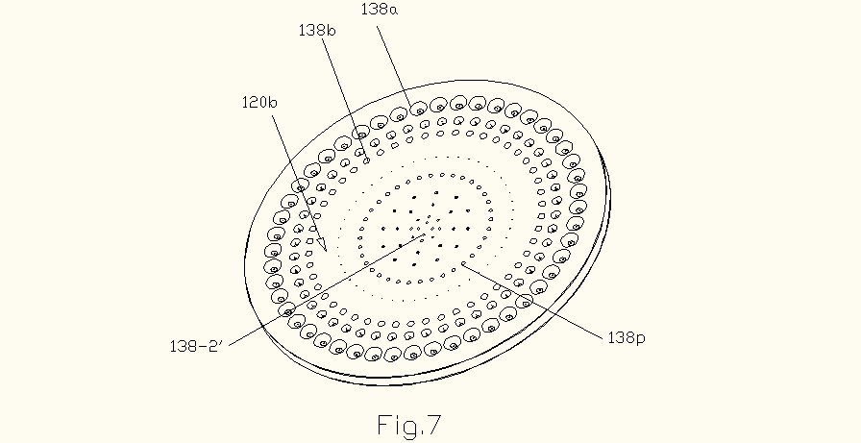
Funneling Of The Gas Holes On Process Surface Faced To Wafer Caused By Non-Uniformity Of Rf Power Deposition In Plasma At Periphery Especially By Edge Effect

Slide 5
In a high frequency approach wavelength becomes commensurable with size of the showerhead and RF power deposition into plasma loses uniformity especially at the edges. High energy ions of process plasma at periphery bombard the outlets and trigger the hollow discharges in the flows of the supplying etching gases inside the holes. In result, the outlets and the adjected inner surface of holes are eroded.

Slide 6
Erosion Of Outlets Of Periphery Gas Holes Caused By Hollow Discharge

Slide 7
Process of Refurbishing Silicon Showerhead

Slide 8
NPS Proposes To Refurbish These Outlets By Simultaneous Investment Of Silicon In Sidewalls By The Side Plasma Beams And Control Geometry Of The Holes By Removing The Extra Silicon From Inner Surfaces Of The Holes By The Axial Beam

Slide 9
Atmospheric Pressure Inductively Coupled Plasma Beam System For Refurbishing Silicon Showerheads

Slide 10
Refurbishing process with simultaneous Si deposition on sidewalls and NF3 etching the hole

Slide 11
AP ICP axial torch reactor with two antennas and ringed torch reactor

Slide 12
Ringed torch reactor with two injectors for vaporization of injected silicon nanoparticles and generation of eight silicon plasma beams for smoothing out outlets of the gas holes

Slide 13
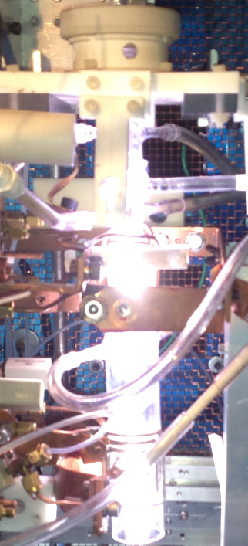
Atmospheric Pressure Inductively Coupled Plasma (AP-ICP) Torch with a long high temperature area for generation of the axial plasma beam from the etching gas NF3 injected into the high temperature plasma. This plasma beam cleans up inner surface of the gas holes from silicon deposited by the multi-beam, but allowing such deposition on the sidewalls for reconstruction of the original geometry of the gas hole

Slide 14
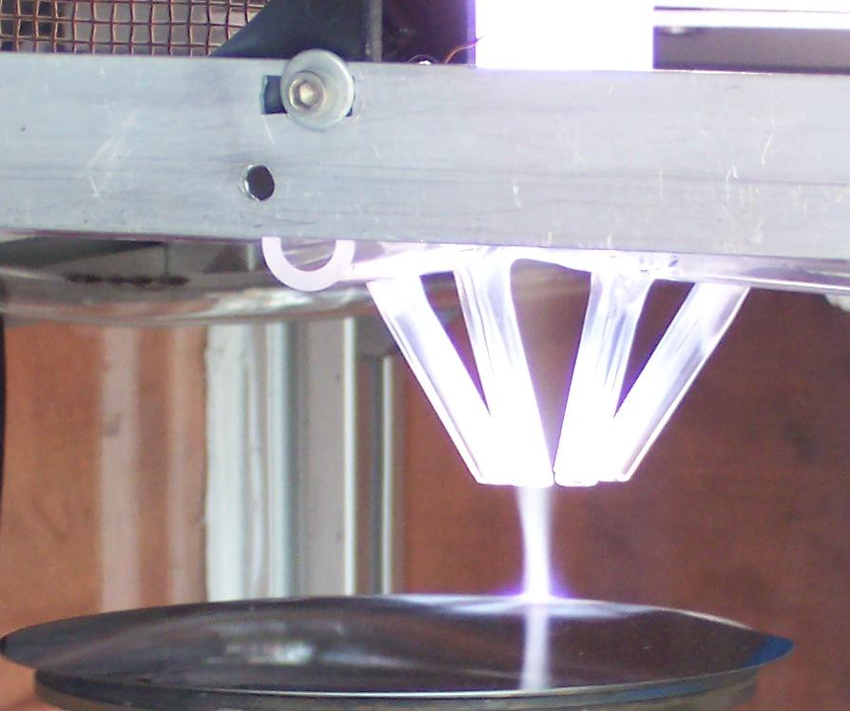
Axial plasma beam for refurbishing silicon showerhead
Notes:
14

Slide 15
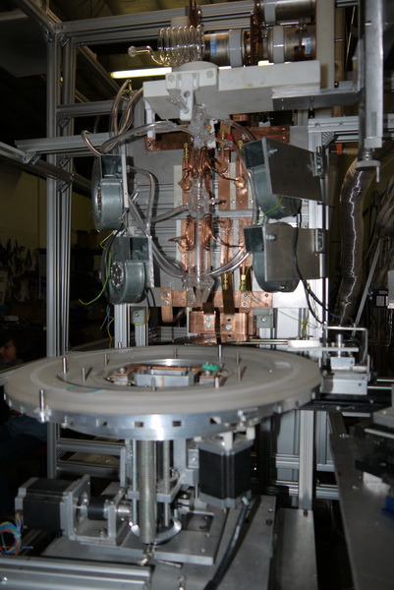
Refurbishing system with fixture
Fixture is designed to hold a showerhead with OD up to 600 mm. It is supplied with a X,Y, Z movement, rotation and tilt for oblique deposition

