Slide 1
Pilot Plant for Manufacturing of the Silicon- Carbon Nanofiber Anodes for Li-ion Batteries
Nanocoating Plasma Systems, Inc. 4432 G Enterprise Street Fremont, CA 94538 415-533-7696 glukhoy1@aol.com

Slide 2
Market Growth
According to Stratistics MRC, the Global Silicon Anode Battery Market is accounted for $96.50 million in 2015 and is expected to reach $1044.96 million by 2022 growing at a CAGR of 40.5% during the forecast period.

Slide 3
Problem and Solution
Currently, most Li-Ion batteries used in EVs provide a driving range limited to 100 miles on a single charge and account for more than half of the total cost of the vehicle. To compete in the market with gasoline-based vehicles, EVs must cost less and drive farther. An EV that is cost-competitive with gasoline would require a battery with twice the energy storage of today's state-of-the-art Li-Ion battery at 30% of the cost. Such problem can be solved using the silicon-containing anodes, especially silicon-carbon nanofiber anodes with the triple-less cost than the anodes manufactured by Sila Nanotechnologies.

Slide 4
High Cost of Core-shell Silicon Anodes
Pure silicon anodes suffer from a large volume expansion of up to 400% during Li intercalation and extraction. Such disadvantage demands reinforcement development of the surrogate silicon anode. Sila Nanotechnologies answered to this demand developing anode that consists of the arrays of the active components and voids. Each active component comprised carbon nanofiber core and silicon shell. Silicon shell is designated with thickness that can provide a controlled and directed inward expansion during alloying with Li ions. Each void is designed to accommodate such expansion and eliminate collisions with other active components inside the array. Size of voids is also designed to secure electrical contact during expansion during charging and contraction during discharging.

Slide 5
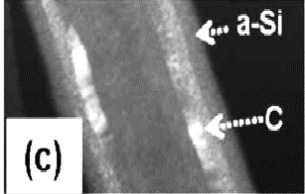
j
Core-shell composite - new solution for silicon anodes
SILICON
SHELL
CARBON
NANO-
FIBER CORE
Fig. 1 Micro-picture of Carbon Nanofiber (core)
encapsulated by silicon (shell)

Slide 6
Proposing the revolution design of the silicon-based anodes with core-shell composite Sila Nanotechnologies, nevertheless, did not develop the cost-effective method its fabrication. In order to reach a total Si encapsulation Sila exposes CNFs in a forest-like arrangement to silicon flow during CVD process.
Forest Architecture of Anodes

Slide 7
Why is it Expensive? Too many steps Multi-step Sila Process of fabrication of the Si/CNT anodes
1. False Substrate Iron nanoparticles are initially distributed on the false substrate (quartz) as seeds or CNT growth.
2. Chemical vapor deposition process (CVD) at low pressure. Upon activation (e.g., chemical vapor deposition, CVD, at elevated temperature and low pressure, the CNT array begins to grow. CNTs were synthesized at 820.degree. C. via a low pressure (10 Torr) CVD process by using an iron (II) chloride catalyst and acetylene gas precursor.
3. Weakening by oxygen Transferring the CNT array to the copper current collector. Its interface with the substrate may be weakened at a desired location.
CNT array is exposed to an oxidizing agent (e.g., H.sub.2O vapors at elevated temperatures) in the vicinity of the catalyst nanoparticles on the quartz substrate.
Oxidizing the CNT array close to the substrate weakens its adhesion. The CNT array is then easier to separate from the substrate. (e.g., mechanically, using an adhesive, etc.), and ready for subsequent transfer to the conductive layer.
4. More steps described in diagrams.

Slide 8
Sila Process
Introduction of False quartz substrate
Distributed deposition of iron nanoparticles
3. Growth of CNTs in acetylene
4. Wakening the CNTS

Slide 9
Diagram of Transferring
5. Cutting the roots CNTS
6. Binder coating CNTs
7. Bonding of top of CNT forest to the current collector
Sila uses binder for electrical connection complicating access of Li to silicon

Slide 10
We challenge the expensive Sila anode manufacturing process with the following:
1. Commercial CNFs serve as the precursors
2. 0.5% Silane is precursor serves for generation of Si vapor
3. Atmospheric Pressure Inductively Coupled
Plasma torch is used for decomposition of silane
4. Long plasma beam with Si is used for CVD process in the fly
Multi – flow injector is used for CVD in the fly
Nozzle and extractor are used for printing the Si/CNFs on the copper foil
Aluminum oxide coating is used for:
Developing the artificial SEI layer
Protection of Si from oxidizing
Protection of Si from HF

Slide 11
Lattice Architecture
We challenge the Sila Si/CNF multi-step method of fabrication of Si/CNF anode with forest architecture with our new Si/CNF anode with lattice architecture

Slide 12
Fig. 2 3D Lattice Architecture of Anode

Slide 13
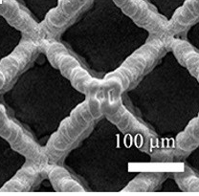
In our binder-less technology 3D plasma beam having a high temperature provides knitting of deposited lattice and its bonding to electro-platted by tin copper collector for electrical contact
Inner Electrical Coupling of Lattice
Fig. 3. Knitting Si/CNFs lattice and bonding to current collector by high temperature plasma beam fusion

Slide 14
Fig. 9. Process of encapsulation, focusing the Si/CNF beam and 3D printing the Si/CNF anode

Slide 15
Open Air Technology
Three raw materials are used to manufacture this anode for Li-ion batteries
1. Commercial Carbon Nanofibers (CNFs)
2. Process gases: silane, Ar and (Ar+H2)
3. Commercial A2O3 nanopowder
Two - step process:
First step:
a) Decomposition of silane in high temperature plasma discharge
b) focusing silicon vapor
c) CVD in the flight coating of the injected CNTs
d) deposition of Si/CNTs on the current collector
Second step:
Deposition of AL2O3 SEI layer on the Si/CNT anode

Slide 16
Problems Encountered
Problems: 1. Short resident time of CNT in the silicon vapor stream
2. Oxidation of silicon in the fly in atmosphere
3. Oxidation of Si/CNTs on the copper anode
4. Low electrical contact with current collector
Solutions:
1. Transition of molecular hydrogen in the atomic one
2. Hydrogen discharge and hydrogen plasma beam
3. Post - deposition coating of Si/CNT anode by Al2O3
4. Electroplating the copper foil by tin
5. Plasma beam knitting the Si/CNF lattice

Slide 17
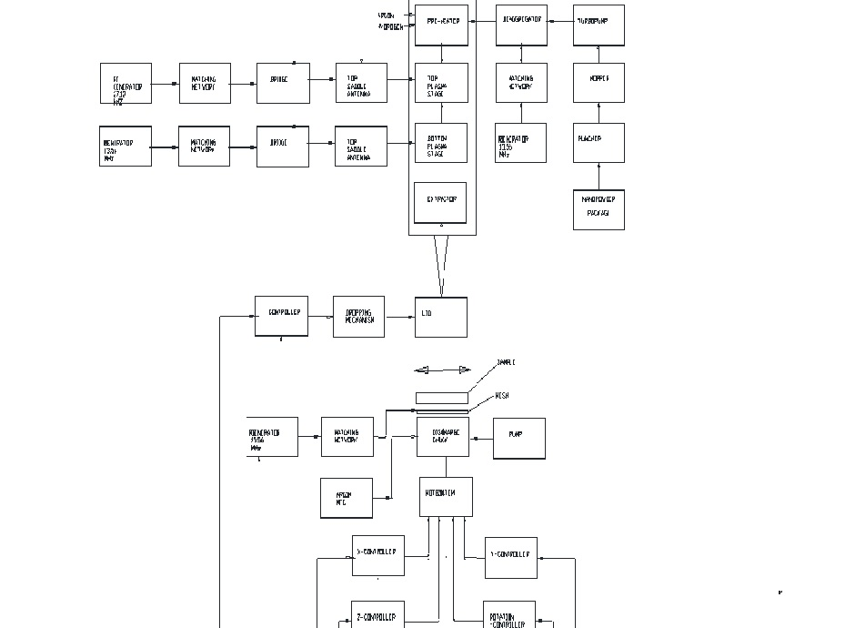
Block Schematic of Silicon Anode Manufacturing Process
Deposition system includes:
Nano-delivery unit
De-aggregator
Pre-heater
AP-ICP pre-melting stage
AP-ICP vaporizing stage
Nozzle
Extractor

Slide 18
Toroid plasma reactor with two inductors for generation of toroidal plasma torch for pre-heating of carbon nanofibers and splitting them in plurality of CNF flows directed to a linear silicon vapor flow
Toroidal Plasma Reactor
Immersed into silicon vapor each CNF absorbs a thin layer of silicon

Slide 19
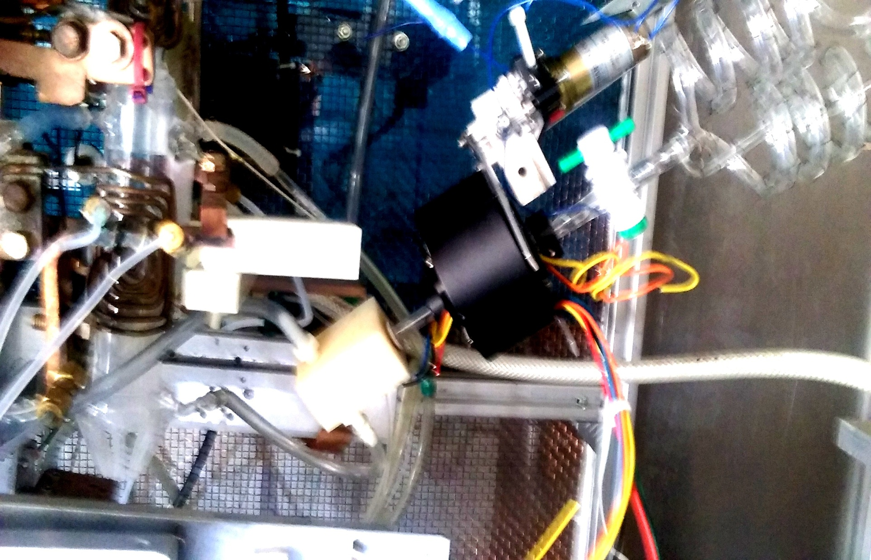
Injection of CNTs Into the Silicon Vapor Beam
Metering of delivered CNFs for heating in the toroidal torch In order to enhance adsorbing of silicon in the flight is provided by the rotatable bi-spiral system

Slide 20
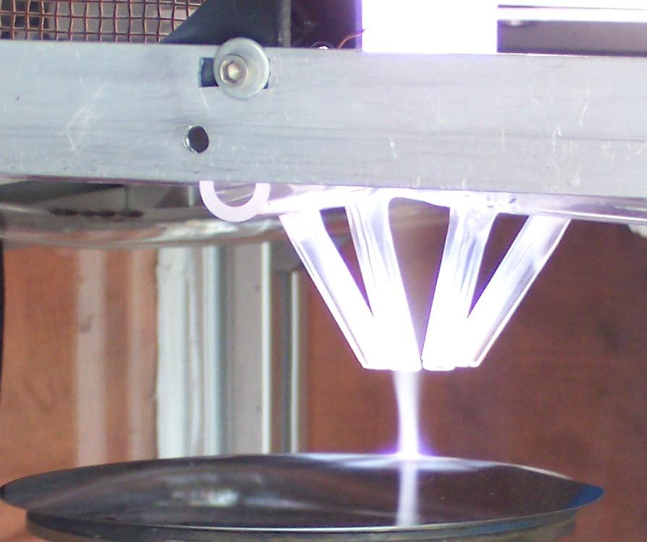
CNFs are injected into the axial silane torch and together with a silicon vapor move to the copper collector exposing their shells for the 3D CVD process. At the long plasma torch around 100 mm the shells can be totally covered by silicon vapor during their flight and additionally coated on the substrate. Such dense enveloped silicon coating with the distributed voids allows reducing of thickness of the anode up to 15 um and provide a current density up to 10 A/sq.m and power up to 150W/h
Silicon Torch
Notes:
20

Slide 21
Package with nanopowder is confined in the puncher’s chamber filled out by argon.
Deposition of Artificial SEI Layer
This layer serves simultaneously for protection of Si from oxidation and from etching by HF from electrolyte. We have developed a conformal coating of Si/CNFs by Al2O3 vapor beam. Precursor is commercial nanopowder of Al2O3.

Slide 22
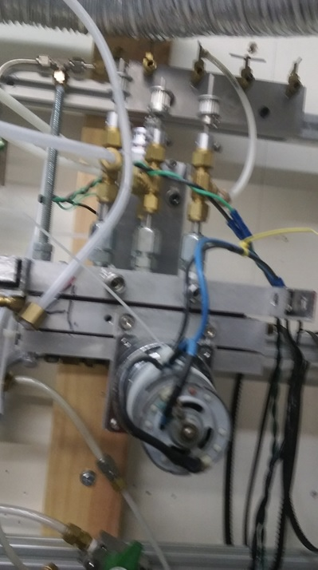
From Shipping Package to Conformal Thin Film
Commercial shipping package is punched in the puncher comprising the pressure chamber with the cutters, mesh, membrane, and vibrator.
Nanopowder after punching of package is dropped on a vibrating membrane and collected in the funnel in the center of membrane.

Slide 23
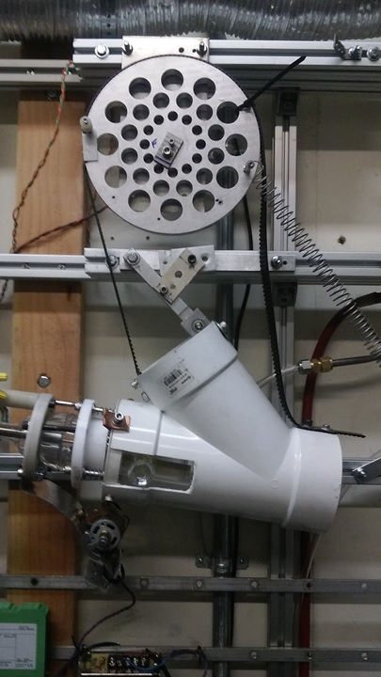
From Powder to Cloud
Nanopowder from puncher is injected by argon flow in hopper that is a glass vessel equipped by the impeller generating nanopowder cloud. To prevent deposition of nanopowder on the inner wall of the glass vessel hopper is also equipped by vibrator and shock wave generator.

Slide 24
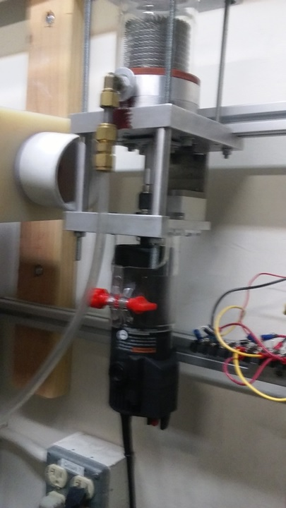
From Cloud to Plasma
Turbopump serves to generate the nanoparticle flow from cloud and deliver to the de-aggregator. sucking cloud through valve at outlet of the hopper.
High nanopowder feeding rate is provided at a high speed of turbine.

Slide 25
SEM Picture of Nanocoating 2500 x 10 min
Cluster
Notes:
25

Slide 26
Our pilot plant for manufacturing the large format Li-ion batteries consists of three atmospheric plasma ICP linear torches oscillating in the Y-direction to provide the lattice structure and Roll-to-Roll system

Slide 27
Roll-to-Roll system with three plasma jets with one-meter wide deposition area
Manufacturing the Large-format Li Ion Batteries

Slide 28
Such two-staged plasma Jet is supplied by two rectangular antenna and comprises a Rectangular Quartz Plasma Reactor with nozzle ending with 1mm wide and 75 mm long slot and with a slot extractor. It generates the linear plasma beam with deposition spot with thickness 0.1mm
Plasma Jet

Slide 29
One of three linear plasma jets maintained on the oscillating in Y-direction platform

Slide 30
Our Advantage
Nanocoating Plasma Systems, Inc. accommodated the core-shell architecture to the Open Air additive manufacturing drastically reducing the cost. To realize lattice architecture, we developed new method and tools as backbone of our power plant where many of complicated and expensive conventional processes can be replaced by one-setup, vacuum-less coating process. to free more space within the cell for storage the 3D printing was applied. These novel manufacturing techniques will also increase the energy density of the battery and decrease cost and reduce the size of the battery's components.

Slide 31
Potential Impact
If successful, NPS new core-shell manufacturing process would enable production of low cost, high energy density batteries that improve the driving range and lifespan of EVs, thus making EVs more affordable and attractive to consumers.
Security:
Increased use of EVs would decrease US. dependence on foreign oil-the transportation sector is the dominant source of this dependence.
Environment:
Greater use of EVs would reduce greenhouse gas emissions, 28% of which come from the transportation sector.
Economy:
This battery with the NPS core-shell anode would enable an EV to travel from Chicago to St. Louis (300 miles) on a single charge, for less than $10 on average.

