Slide 1
3D Printing of Silicon-Carbon Nanofiber (Si/CNF) Anodes with Silicon Encapsulation of CNFs in the fly for Manufacturing Large-format Li-ion Batteries (LiBs)
Nanocoating Plasma Systems, Inc.
4432 G Enterprise Street
Fremont, CA 94538
415-533-7696
glukhoy1@aol.com

Slide 2
3D Printed Li-ion Batteries
3D printed battery manufacturing has opportunity to be an efficient and versatile platform technology to enable shape-versatile/monolithic-integrated power sources with functionalities far beyond those of conventional batteries.
In the conventional battery 30-50% of the total electrode volume is unutilized, because of a low surface area of active materials and complicated access of lithium ion for them to provide an elctro-chemical reaction.
Layer-by-layer spray printing may provide the intrinsic properties of electrode materials. Having high-energy and high-power-density they may serve as promising energy storage systems for electric vehicles (EV).

Slide 3
Benefit of 3D Printing of LiBs
compared with the conventional electrodes made by the slurry methods. The 3D electrodes of LiBs possess several distinct merits over traditional flat electrodes, such as
1. Higher surface area
2. Shorter ion transport path
3. Improved mechanical strength
4. Integration with other sources of energy (solar cell, fuel cell, etc.)
Benefiting from these advantages, the 3D-printed electrodes present the higher specific capacity and improved cycling stability.

Slide 4
Silicon Anodes Less Likely To Be 3D Printed
Silicon is an attractive anode material because it has the highest known theoretical lithium ion storage capacity of any material At room temperature, silicon can alloy with lithium to form the Li15Si4 state, reaching a theoretical capacity of about 3579 mAh/g. At elevated temperatures, silicon can alloy with lithium to form the Li22Si5 state, reaching a theoretical capacity of 4200 mAh/g. These are both about 10 times that of the theoretical capacity of graphitic carbon (372 mAh/g).

Slide 5
Atmospheric Pressure Inductively Coupled Plasma Jet vs Aerosol jet
Nowadays, main instrument for printing lithium-ion batteries is Aerosol jet. Printable inks of two pairs of active materials for cathode and anode are printed into Li-ion battery electrodes providing specific capacity comparable to conventional slurry cast made electrodes. It was reported, that the additive cathodes with LiCoO2 exceeded performance of conventional cathodes.
However, attempt to print the silicon anodes was not successful, although today LiBs for EV are in transition stage from graphite anodes to the more powerful silicon ones.

Slide 6
Silicon-Carbon Nanofiber (Si/CNF) Composite
Manufacturing anodes of such advanced Li-ion batteries requests the silicon-containing CNF composite with a special shell-core configuration. However, 3D Printing technology is not ready yet because encapsulated by silicon carbon nanofibers (CNF) for the anode manufacturing should be developed. Nobody can develop the requested silicon-shell and CNF structure although, carbon nanofiber is a low-cost commercial product. Therefore, some companies like Sila Nanotechnologies Inc. grow own CNF using the low-productive multi-step CVD method, expensive semiconductor equipment in order to build a forest-like 3D structure and deposit silicon to cover the total surface. Besides high cost, such architecture complicates lithium penetration in anode. If the low cost encapsulation of CNF by silicon were developed, 3D printing would provide the optimal architecture with the highest lithium penetration and utilization of the anode surface.

Slide 7
Atmospheric Pressure Inductively Coupled Plasma Jet vs Aerosol Jet
Electrode-printing technology has showed the advantage of the lattice-like, interlaced structures with complex geometries as the potential strategy to fabricate electrodes with high areal energy density and power density. Particularly, Aerosol Jet has assembled such architecture using the droplets of the commercially available powder of active materials. However, Atmospheric Pressure Inductively Coupled Plasma Jet can assemble layer by layer the same 3D lattice architecture but from silicon-carbon nanofiber (Si/CNF), wherein Si/CNF composite in the core-shell structure can be generated by the same jet simultaneously with building such architecture. Moreover, high temperature plasma beam can provide welded knitting this lattice for electrical contact as well as bonding to the copper current collector eliminating binder.

Slide 8
In order to bringing the new battery to the market its specific energy density should be of ∼300 Wh/kg and a power density should be of ∼2500 W/kg. It can be provided by fabrication the 3D silicon anodes that would provide high capacity because of high surface to weight ratio.
Although silicon anodes have the potential to far-exceed the lithium ion storage capacity of conventional carbon anodes, they change size because of alloying with Li. Despite the increased capacity that would be given to Li-ion battery by pure silicon anode such physical swelling and shrinking results in a quick wrecking the structure of any silicon battery.
3D Silicon Carbon-Nanofiber (Si/CNF) Anode

Slide 9
Opportunities
Our opportunities to win market are silicon encapsulation, 3D lattice printing and high temperature bonding to the current collector. It is based on:
Lattice printing 3-D method that can create low-weight and high-energy-capacity batteries.
Silicon encapsulation gives to batteries faster recharging times and, when used in electric cars, longer range time.
3D architecture allows the lithium to penetrate through the anode that results in high electrode utilization, and thereby higher energy storage capacity.
High temperature bonding allows elimination of binder for electrical
contact.
V. Vacuum-less and enclose-less large-format manufacturing
reduces cost of the LiBs that should be lower than $100/kWh.

Slide 10
Silicon Encapsulation In the Fly
Serving as a building material for printing the volumetric anode on the copper foil with the 3D architecture Si/CNF shell-core composite is prepared simultaneously with deposition by encapsulation by Si of the commercial carbon nanofiber in the fly. It is provided in the high temperature plasma saturated by silicon. Injected CNF should have resident time to develop the Si shell with thickness 12 nm before injection as Si/CNF in atmosphere as the beam for deposition.
Fig. 1 shows the shell-core structure of Si/CNF.
Fig. 2 shows the architecture of the volumetric anode with the reserved compartments to accommodate silicon swelling during charging.

Slide 11
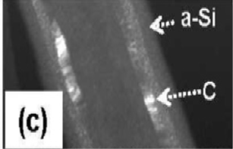
















j
SILICON
SHELL
CARBON
NANO-
FIBER CORE
Fig. 1 Carbon Nanofiber (core) encapsulated by silicon (shell)

Slide 12
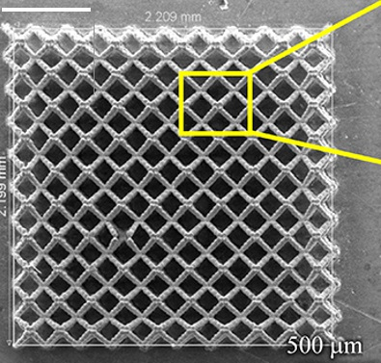
Fig. 2 3D Lattice Architecture of Anode

Slide 13
Tin and Plasma Beam Knitting vs Binder
It might be assumed that the binder in the conventional silicon anodes hinders access of the electrolyte to the surface of silicon layer until some pores appear in the course of several cycles.
Elimination of the binder can raise the specific capacity. However, its main function to provide adhesion to the current collector in alternating in the silicon shell size in cycling changing, may adversely affect the retention of the reversible electrode capacity.
Such function should be transferred to the tin electroplated on the copper foil. Like silicon tin participates in the Li interaction and swells during lithiation. However, spacing in the lattice can absorb such expansion.
Electrical connection between the printed layers is provided by welded knitting the lattice by the focused high temperature plasma beam simultaneously with printing this lattice.

Slide 14
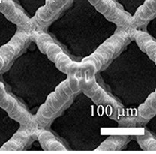
3D plasma beam having a high temperature can provide knitting of deposited lattice and its bonding to electro-platted by tin copper collector for electrical contact eliminating binder (Fig. 3)
Fig 3. Knitting Si/CNFs
lattice and bonding
to current collector
by high temperature
plasma beam fusion

Slide 15
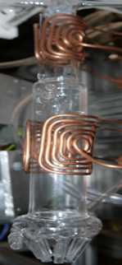
Fig. 4 AP ICP axial torch reactor with two saddle antennas and doughnut-like circular torch reactor
Atmospheric Pressure Inductive Coupled Plasma Jet
AP ICP jet includes two reactors. Two-stage-reactor (Fig. 4) is equipped by two saddle antennas. Each antenna comprises two branches with the rectangular coils bended to fit to outer walls of the reactor. Both branches are connected in parallel to reduce impedance and compensate the parasitic capacitive coupling leading to breakdown between the antenna and torch. Each antenna generates the transversal RF field to provide an uniform plasma discharge and a radial high temperature distribution.

Slide 16
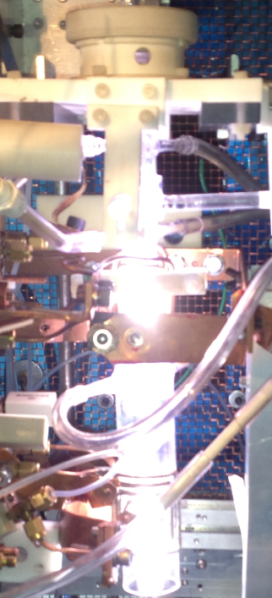
Reactor generates two plasma torches combined together to provide a long high temperature area.
Silane injected into the top plasma torch is decomposed generating Si vapor.
Nozzle at the end of reactor narrows plasma stream with Si and generates the axial flow of Si vapor. CNFs are injected tangentially in this flow.
Fig.5 AP-ICP torch
Atmospheric Pressure Inductively Coupled Plasma (AP-ICP) Torch

Slide 17
Fig. 6 Doughnut-like plasma reactor.
Doughnut-like Plasma Reactor
This reactor (Fig. 6) generates a circular plasma torch for pre-heating of injected inside CNFs. It is equipped with two inductors and six capillaries. Inductors generate this torch, but the capillaries split it in six flows directed tangentially to an axial silicon vapor flow. Immersed into Si vapor each CNF absorbs a thin layer of Si.

Slide 18
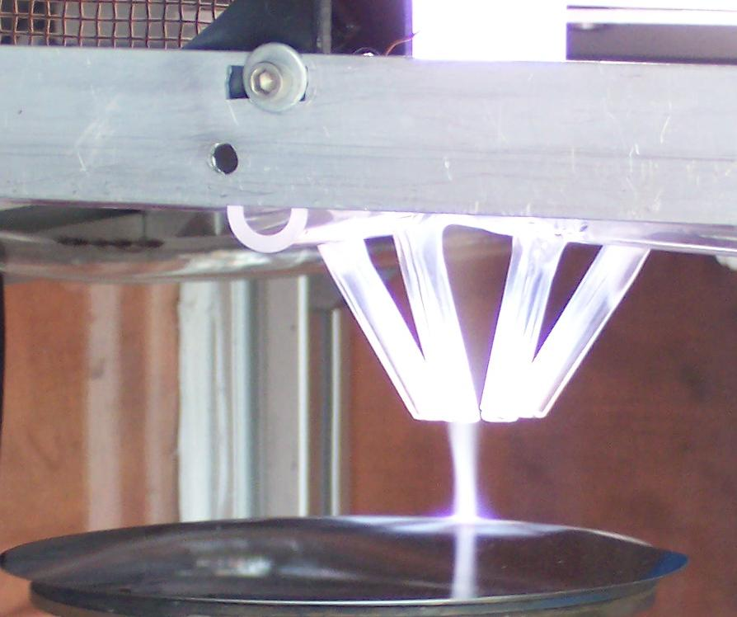
Plasma Beam with Carbon Nanofiber Encapsulated by Si
Fig. 7 Atmospheric Plasma Beam
Silicon Nanofiber is encapsulated with thickness of Si shell up to 12 nm and together with plasma beam is delivered to substrate (Fig. 7).
Notes:
18

Slide 19
Injection of Carbon Nanofiber Into Doughnut-like Plasma Reactor
Centrifuge (Fig. 8) for injection of CNFs consists of two welded tubular spirals that deliver doses of CNFs to doughnut-like reactor. In the reactor CNFs are heated by the circular torch for following absorption of silicon. However, doses determining deposition rate are limited by sustainability of plasma torch. Stability of torch is controlled by revolution of centrifuge.
Fig. 8 Rotatable tubular centrifuge for injection of Carbon nanofiber into doughnut-like plasma reactor

Slide 20
Applications of 3D printed LiBs
Application #1 Large-Format 3D printed Si/CNF anodes for EV LiBs
Si-carbon nanofibers are deposited from both sides on the copper tape electroplated by tin for better adhesion of the printed lattice to the current collector. Lattice itself is thermally knitted through welding by the focused thin plasma beam simultaneously with deposition. The copper tape is carrying the tape by the drum (Fig.9) with a high revolution. Pulsing axial motion is provided to build the multi-staged lattice architecture.

Slide 21
Fig. 9. Process of encapsulation, focusing the Si/CNF beam and 3D printing the Si/CNF anode.

Slide 22
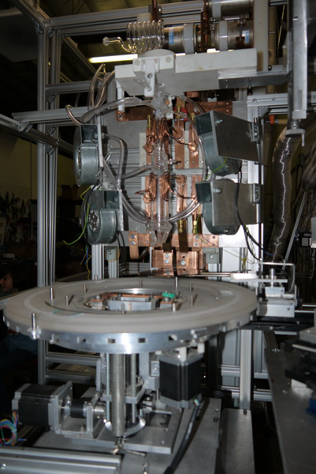
Fig.10 3D printer with AP-ICP beam with fixture for microchip manufacturing with printed LiBs
Application #2. Integration of Printed LiBs into Semiconductor Devices
Although our 3D printer is equipped by a drum and tape-motion system it is also can be supplied by a fixture for wafers for integration of printed LiBs directly into silicon-based semiconductor devices. Such printer opens paths towards the development of new mobile micro-electronics applications.
Fixture (Fig.10) can hold wafer with OD up to 450mm. It is supplied with a X,Y, movement, rotation and tilt.

Slide 23
Solid Electrolyte Interphase (SEI) Problem and Solution
During electrolyte interaction with silicon the solvent and lithium salt in the electrolyte form an insoluble film called the SEI layer. When the lithium ions are intercalated into silicon shell, the silicon shell expands in volume and decomposition of the electrolyte causes the formation of an SEI layer. When lithium ions are removed from silicon, the shell decreases in volume. This large volume decrease can cause cracking in the first SEI layer, exposing fresh silicon to the electrolyte. Fresh SEI layer is growing and cracking again. It can hurt cycle life SEI irreversibly consuming lithium ions and electrolyte. In order to prevent growth and fall SEI we can develop a stable artificial SEI layer occupying surface of silicon for a stable cycling in silicon anodes.
Therefore, NPS provides thin conformal coating by aluminum oxide with thickness around of 5-10 nm immediately after the total lattice buildup that can accommodate the large volume fluctuation of Si and to prevent simultaneously:
1. SEI generation
2. Corrosion activity of HF generated by electrolyte
3. Silicon oxidation

Slide 24
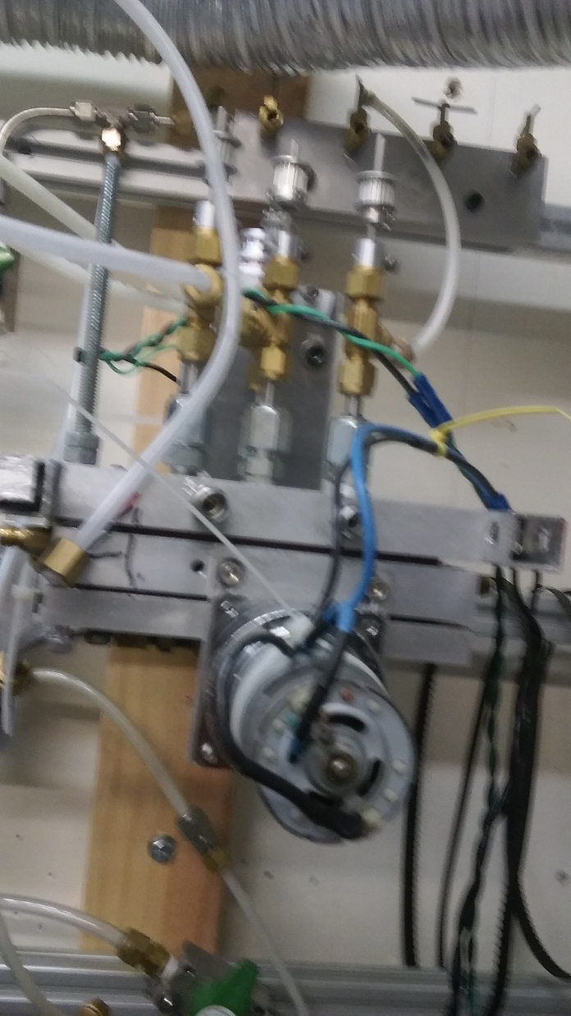
Deposition of Artificial SEI Layer
Artificial SEI Layer is provided by conformal Al2O23 coating of the Si/CNF lattice. This is a final process of 3D printed Si/CNF anode manufacturing. Package with Al2O3 nanopowder is punched in the chamber (Fig.11) with cutters, vibrating meshes and membrane. Nanopowder is dropped on a vibrating membrane, collected by funnel and delivered in turbine that injects it into the same torch instead silane for vaporizing and generation of Al2O3 beam.
Fig. 11. Puncher for shipping package with Al2O3 nanopowder

Slide 25
Conclusion
NPS has developed 3D printer with focused plasma beam:
a) vacuum-less method of manufacturing of the 3D printed Si/CNF anodes from the commercially available precursors like carbon nanofiber and 0.5% silane blended for safety;
b) silicon generation from depleted silane decomposition using atmospheric pressure discharges: dielectric barrier discharge and high temperature inductively coupled one;
c) heating the carbon nanofiber in ringed torch;
d) Si encapsulation of CNFs in the fly during printing the Si/CNF anode;
e) binder-less bonding the Si/CNT lattice to the copper current collector through tin electroplating;
f) Al2O3 conformal coating for protection of Si/CNF anode from SEI generation, HF etching, silicon oxidation.

